Slide 1
Introduction to Python for simulation
April, 2025
Presented by Florian Jacta – Product Specialist

Slide 2
The Goals
Start with 3D Data Visualization in Python
Solve missing information in object
Compute drag for object

Slide 3
PyVista - What it is
PyVista Functions
Python package built on VTK for 3D scientific visualization
Natively supports file formats like .vtp, .vtu, .vtk
Enables interactive 3D plots for volume and surface meshes
Integrates with NumPy for numerical analysis
Read: Import data from formats like .vtp, .vtu, .stl, .ply
Transform/Analyze: Translate, rotate, and scale meshes, compute distances, areas…
Filter: Smooth meshes, extract surfaces, compute normals
Plot: Create 2D/3D visualizations of structured and unstructured data

Slide 4
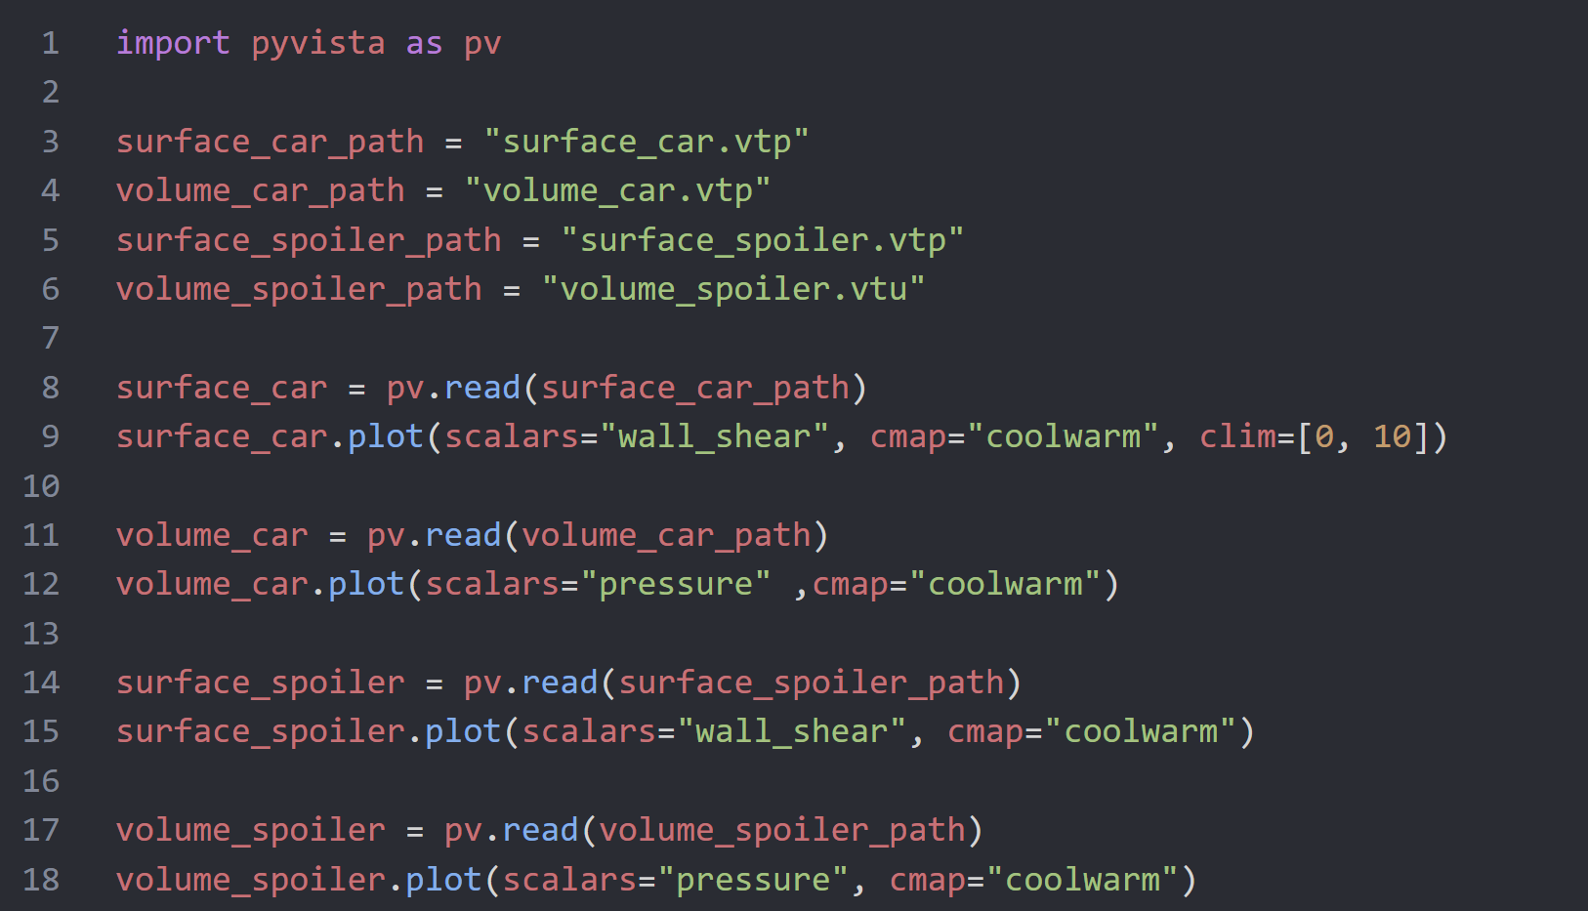
Data Visualization
Steps:
Install PyVista Package
Import it
Read the different files
Plot the files according to existing scalars
You can check which scalars are present in the object with:
volume_car.array_names
Note: SimAI proposes data visualization out of the box.

Slide 5
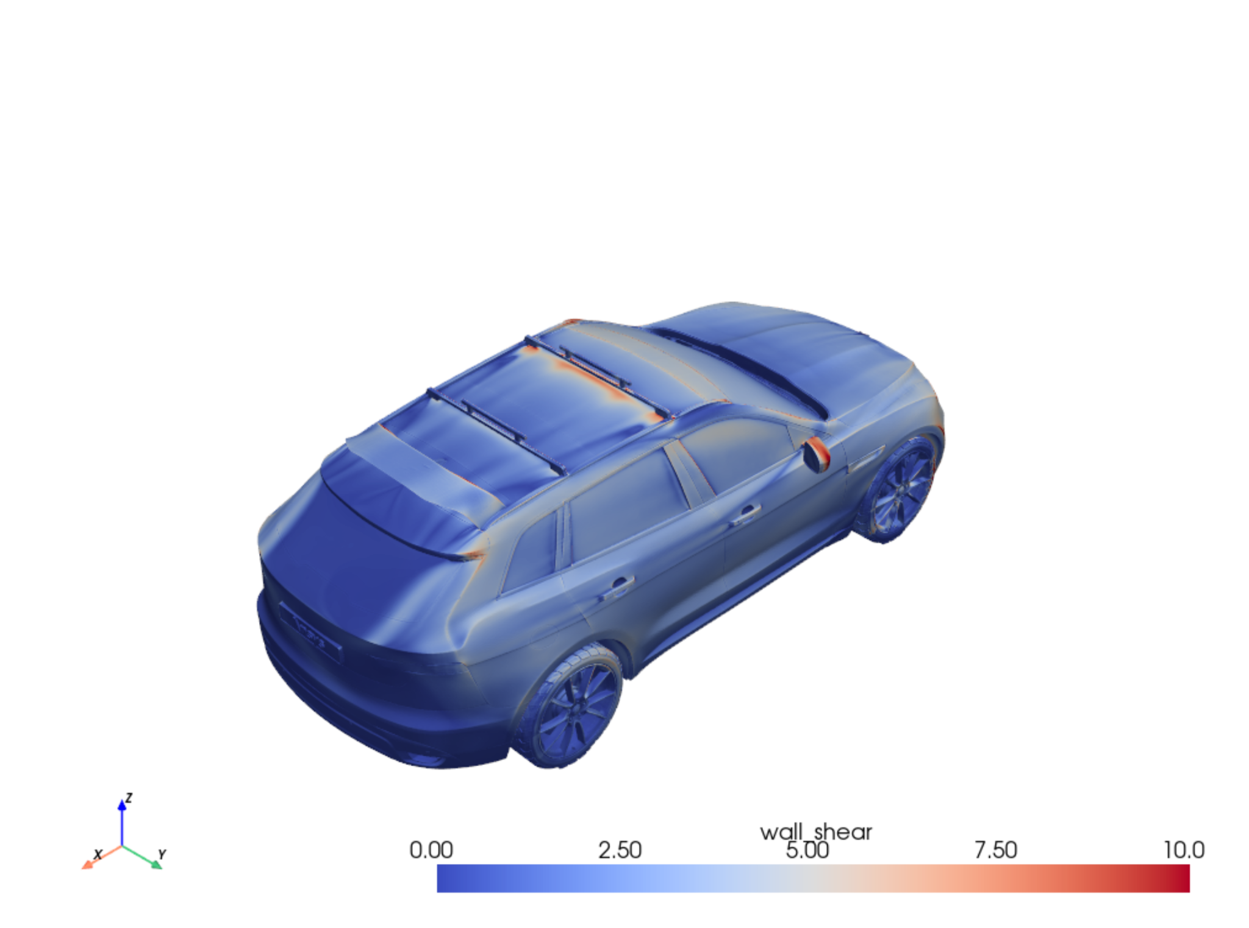
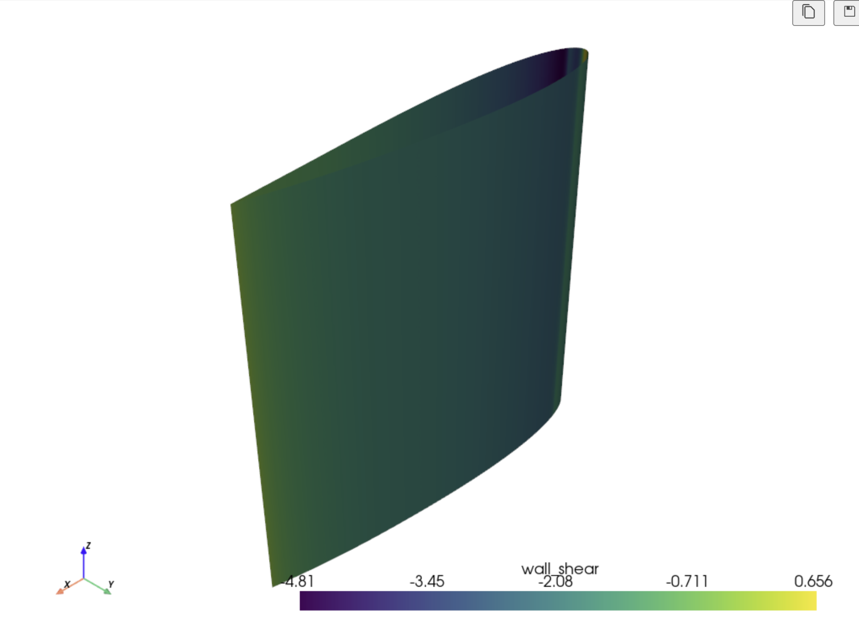
The results

Slide 6

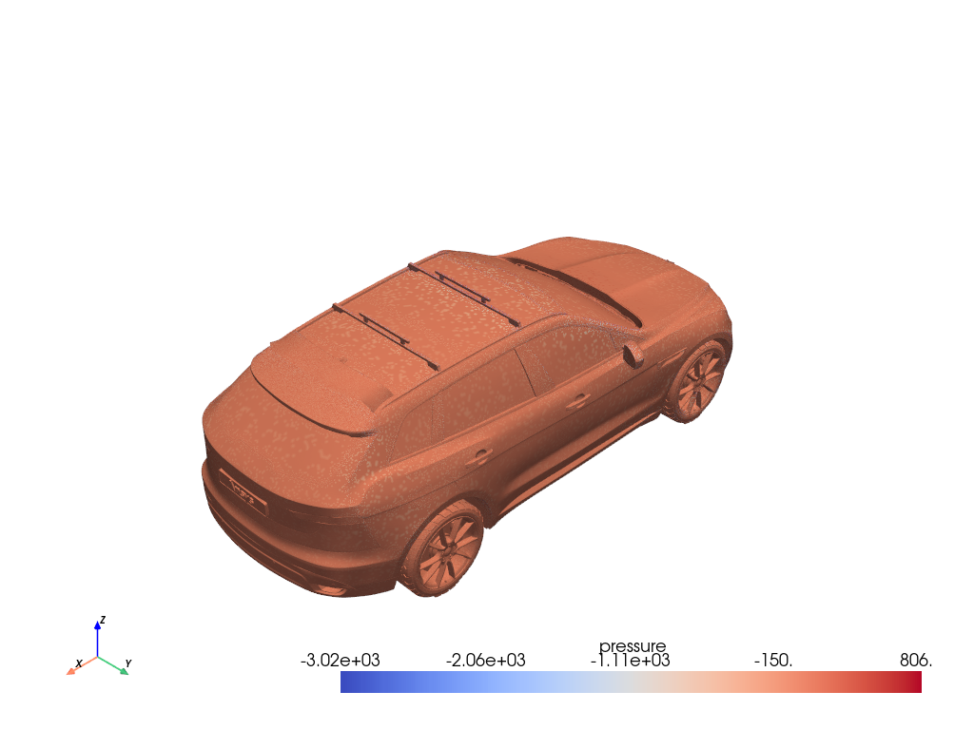
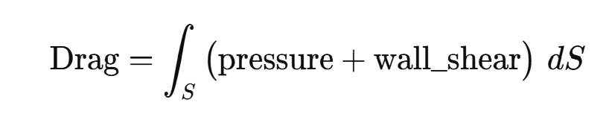
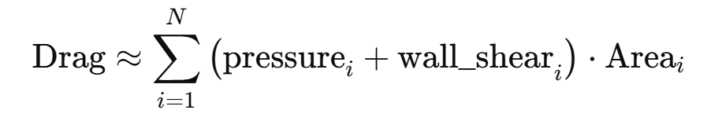
Objective
Surface does not contain the Pressure data but volume does.
Use PyVista’s `.sample()` to interpolate nearest volume data to the surface.
We can use either all scalars from the interpolated surface or a part of it.
Now that we have the pressure thanks to the interpolated surface, we can use this formula:
We can approximate the drag from our data:
Compute drag using surface values.

Slide 7
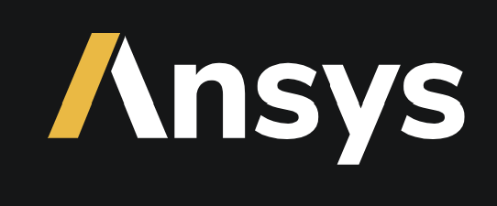
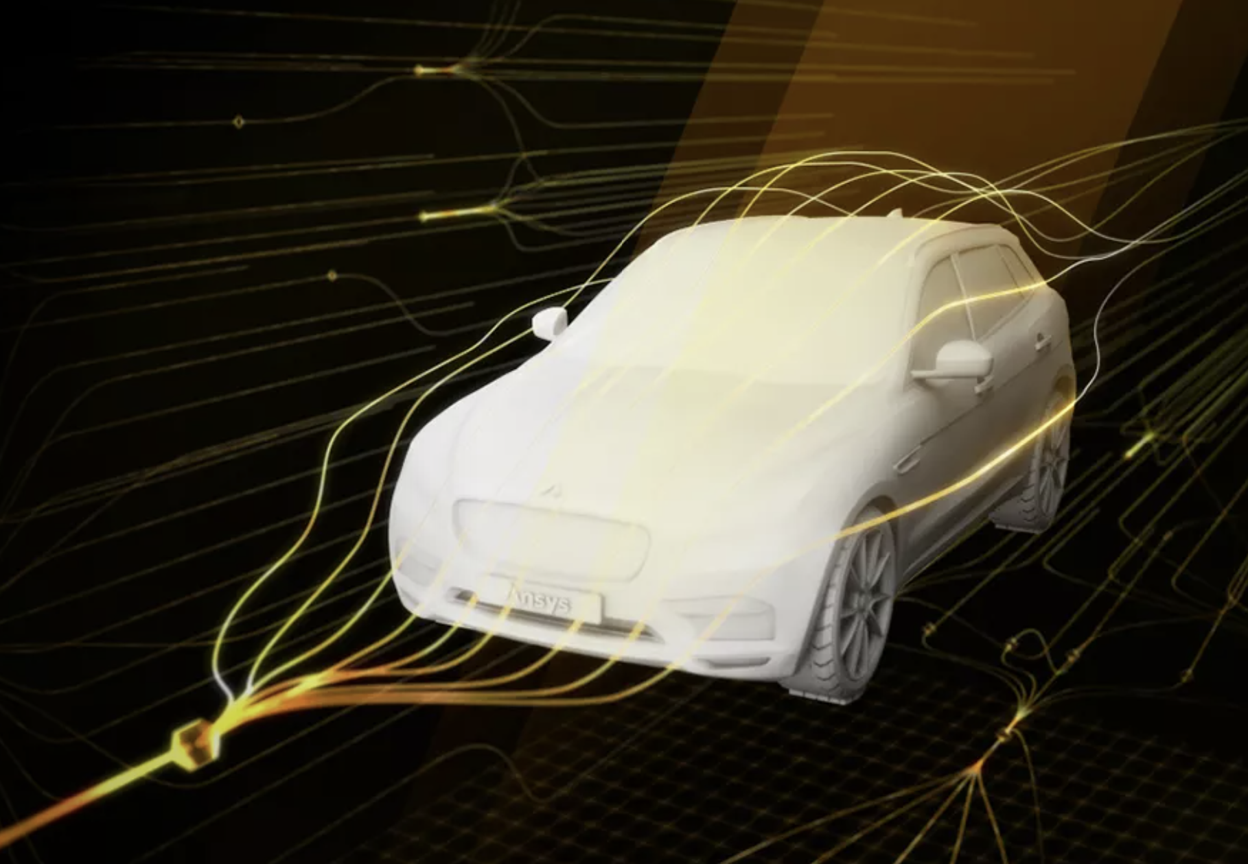

Check the Github and see more on SimAI
Fast and reliable data-driven insights
Intuitive and simple workflow
Flexible deployment options
Expansive design space exploration

